Slide 1



On the origins of cellular differentiation
Gary Tyree, Zach Grocheau-Wright, Dr. Richard Michod
Space Grant Symposium, April 15th, 2016

Slide 2
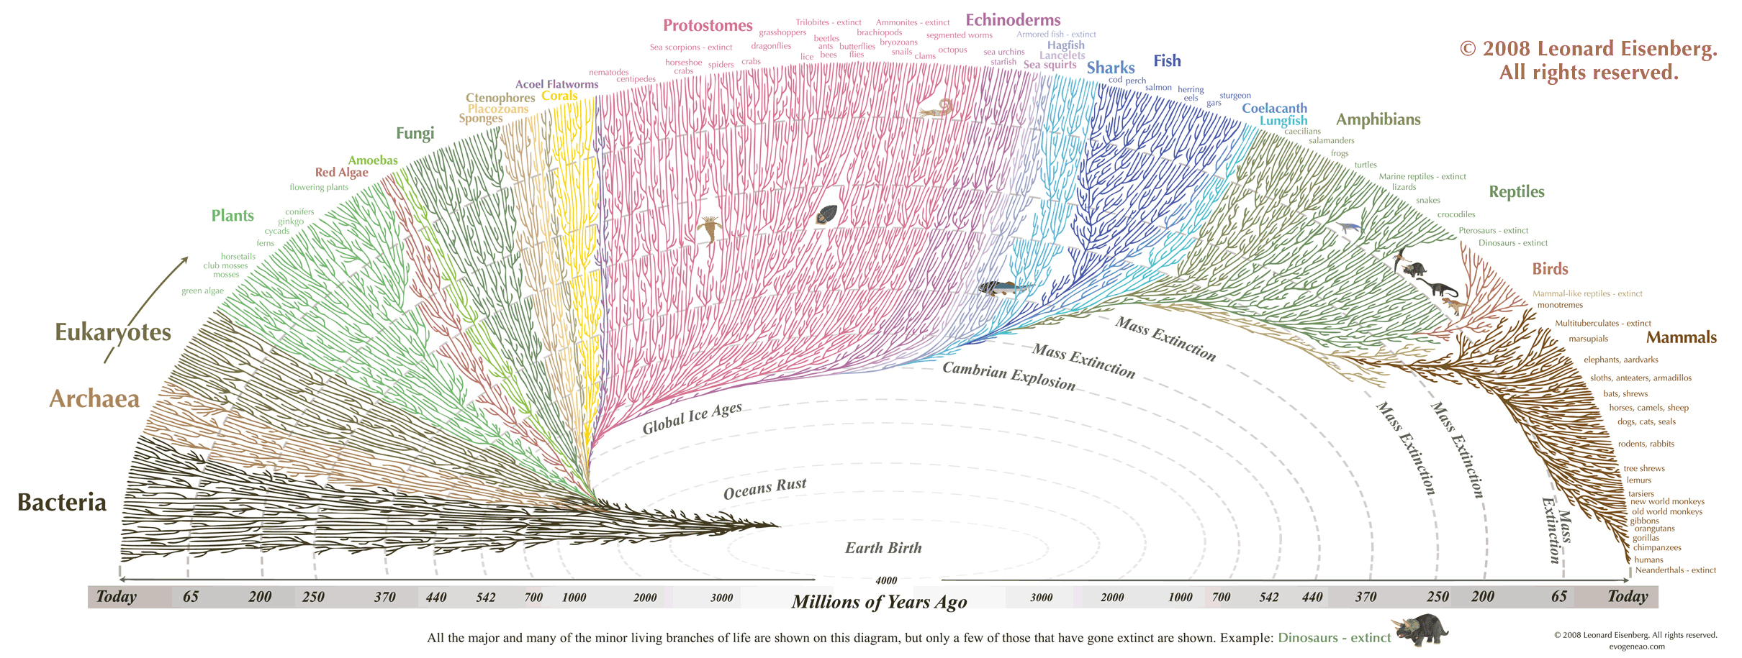
Understanding evolution
Notes:
First I’d like to go over the use of understanding evolutionary trends and causes. These pieces of information hold the key to understanding how life has changed and will continue to change. This information has been able to give us insights into the lives of long-extinct forms of life, effectively a clear window into the past for watching past life. But who’s to say we this window can’t be applied to space too? Understanding evolution can show us how life would form and develop in different galaxies. It would show us a view clearer than any telescope on the possibilities of alien life and astrobiology.

Slide 3
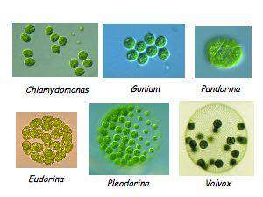
Project Scope
Model Organisms: Volvocine Green Algae
Some of these algae have developed cellular differentiation, some have not
The different species of algae in this group show different levels of complexity
Notes:
Whether its our team or other astrobiologists, we’re all most interested in complex alien life. Finding bacteria on Mars would be amazing and have a huge impact, but a humanoid would be even more extraordinary. For our project, we wanted to look at a specific step in evolution that would be especially informative for understanding complex life. This step, the development of different cell types, plays a key role in the developing complexity of organisms. We picked our model organisms, the Volvocine green algaes, because they are a closely-related group of species that haven’t all developed cellular differentiation. Here you can see an image of various algaes in the group. The first of which, Chlamydomonas, each of these cells is an individual organism. But for Gonium, this cluster of cells is an organism. Each Pandorina is also a cluster of cells, but has a 3d formation as well, unlike the 2d sheet of cells in Gonium. Eudorina has semi-specialized cells, and Pleodorina and Volvox have cellular differentiation. As you can see, in this one group of species, there are various levels of complexity. This is extremely useful for the analysis of these traits.

Slide 4
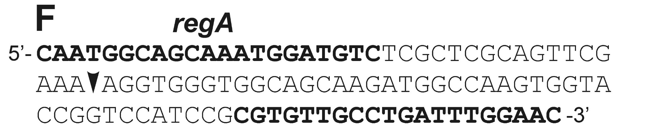
regA Gene
This gene is present in all of the algae, even if they don’t have Cellular Differentiation
Mutation in it causes cell to be unable to control Cellular Differentiation
So it’s thought that changes in regA are what caused Cellular Differentiation
Notes:
Now here’s the technical portion. All of the different algae in our model organism group have a gene called regA, even though they don’t all have Cellular Differentiation. That means the gene is used for some other purpose. But in the species that have Cellular Differentiation, a mutation in regA will cause them to be unable to control their Cellular Differentiation. This leads us to suspect that changes in regA were the cause of these species gaining Cellular Differentiation.

Slide 5
Hypothesis
RegA Evolution: The RegA gene evolved to control Cellular Differentiation.
Gene Network Evolution: The rest of the gene network evolved to control Cellular Differentiation.
Notes:
So here we have our two hypotheses. The first is that changes in RegA are what caused Cellular Differentiation to develop. The second is that changes in the rest of the gene network that interacts with regA are what caused Cellular Differentiation to develop.

Slide 6
Testing regA
There are strains of algae with mutant regA genes, which can’t control their Cellular Differentiation
We put a healthy regA from a species that doesn’t have Cellular Differentiation in the mutant strain of a species that does have it

Slide 7
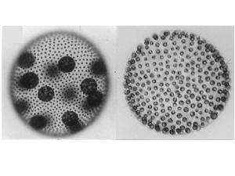
Predictions
If the regA hypothesis were true, then the regenerator mutant would not recover with a healthy regA gene.
If the Gene Network hypothesis were true, then the regenerator mutant would recover with a healthy regA gene.
Recovery?
Regenerator Mutant
Healthy Adult
Notes:
If the RegA hypothesis is true, then the regenerator mutant would not recover with a healthy RegA gene from another species that didn’t have cellular differentiation. But if the Gene Network hypothesis were true, then the regenerator mutant would recover with a healthy RegA gene from another species, even though that species didn’t have cellular differentiation in the first place.

Slide 8
Methods
Set-up
Transformations
Analysis
Notes:
For our methods, we have 3 steps, as shown here.

Slide 9
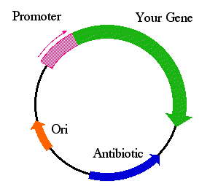
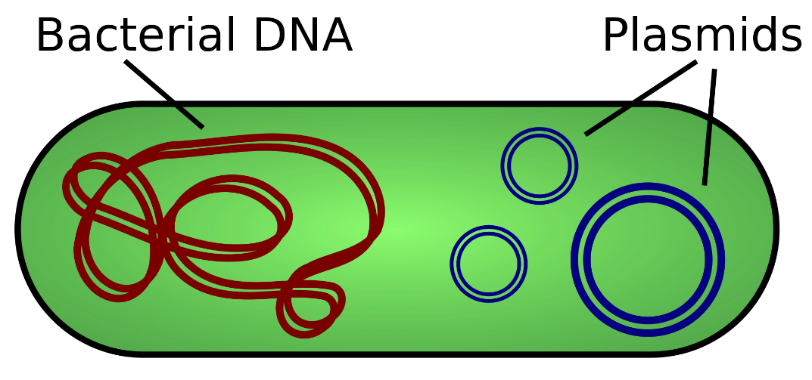
Methods: Set-up
A depiction of Plasmids inserted into a bacteria cell
What’s inside the plasmid
Notes:
In this step, we had to make a plasmid, or a circular piece of DNA, to hold the regA gene and have a selectable marker. Our selection marker would give any cells that adopt the DNA a resistance to an antibiotic called Hygromycin. We need this because not all the cells will adopt the DNA into their genome when we try to transform them. With this selectable marker, if we put the cells we tried transforming in Hygromycin, then only the cells which got the DNA will live and we can pick them out so that all the cells we look at have the healthy regA gene. This was the most time consuming step, as we had to experiment with several different plasmid types, types of selection markers, levels of selection markers, and enzymes needed to create the plasmid.

Slide 10
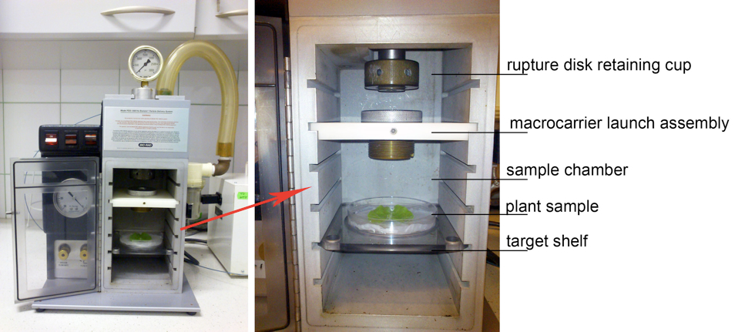
Methods: Transformations & Analysis
We are using a BioRad PDS-1000 gene gun to put the healthy regA in the mutant
It shoots gold microparticles laced with a piece of DNA we want to integrate into the target’s genome
Notes:
After setting up for the transformations, we were able to start the process of trying to input the DNA into the mutant strain. To do this, we put the plasmids we created that carry the regA gene and the selection marker into gold microparticles and shoot them out of this gene gun. After shooting the mutant strain, we would put them in the selection marker and look for cells that did not die in the antibiotic. These cells would be picked out of the group of dead cells and placed together in another container. That’s if we get multiple cells that intake the plasmid though. On average, the target will intake the plasmid once for every ten thousand cells we shoot. So it would still take several shots to get one transformation. That’s why we are currently still working on this step.

Slide 11
Methods: Analysis
Recovery?
Healthy Adult
Notes:
Lastly, we have to look through the transformed cells and see if any of them are recovering or not.

Slide 12

Summary
Notes:
If we can understand the cause of cellular differentiation, we’ve taken a huge step towards understanding the general development of complexity. This in turn will inform us of the necessary requirements to developing complexity, which will show us how and what it takes for alien life to become complex.

Slide 13
Special Thanks
Michod Lab
  Dr. Patrick Ferris
  Erik Hanschen
  Dinah Davison
Fares Lab
UA-NASA Space Grant Program
NASA
NSF
Notes:
I’d like to give some thanks to everyone in the Michod lab for answering my questions and always helping me. Additionally, the Fares lab has allowed us to use their gene gun, which was really kind of them. Thanks are needed for the UA-NASA Space Grant Program for giving me this opportunity. Also, NASA and the NSF for their funding.

Slide 14
Works Cited
http://e.fastcompany.net/multisite_files/codesign/slideshow/2012/09/1670898-slide-0-evo-large.jpg
https://nimravid.files.wordpress.com/2008/04/volvocide-small.jpg?w=490
https://static-content.springer.com/esm/art%3A10.1186%2F1471-2164-7-321/MediaObjects/12864_2006_704_MOESM5_ESM.jpeg
http://www.bio-protocol.org/attached/image/20131231/20131231214921_0080.jpg
https://upload.wikimedia.org/wikipedia/commons/thumb/c/cf/Plasmid_(english).svg/2000px-Plasmid_(english).svg.png
https://qph.is.quoracdn.net/main-qimg-cec043ac61e46bdb6377cb62090354c0?convert_to_webp=true
http://biology.umbc.edu/files/2013/04/stmiller_researchGroupDesc_2.jpg
http://www.relativelyinteresting.com/wp-content/uploads/2013/02/are-we-alone.jpg

